Slide 1
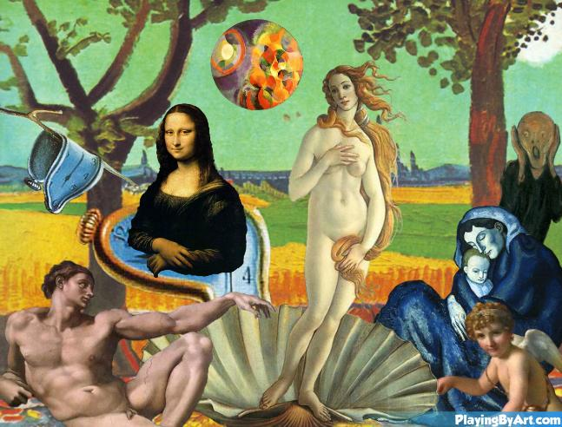
Cut N’ Paste
A Semantic Segmented Style Transfer Tool
097200 - Deep Learning Course Final Project
Yotam Amitai & Tzabar Dolev

Slide 2
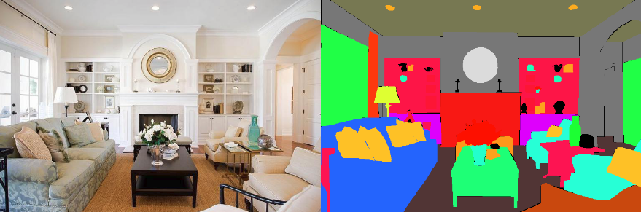
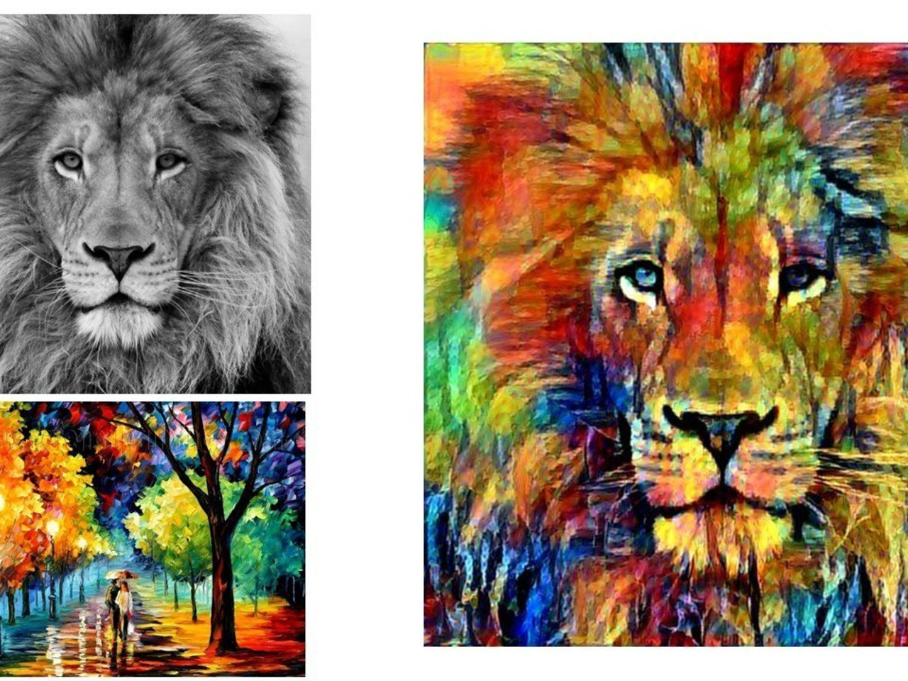
Introduction
Image segmentation and Style transfer are common and popular subfields in Computer Vision.
Image segmentation is applied on most systems that require scene understanding.
Style Transfer utilizes deep learning methods to apply the style of an artistic image onto a scene image.

Slide 3
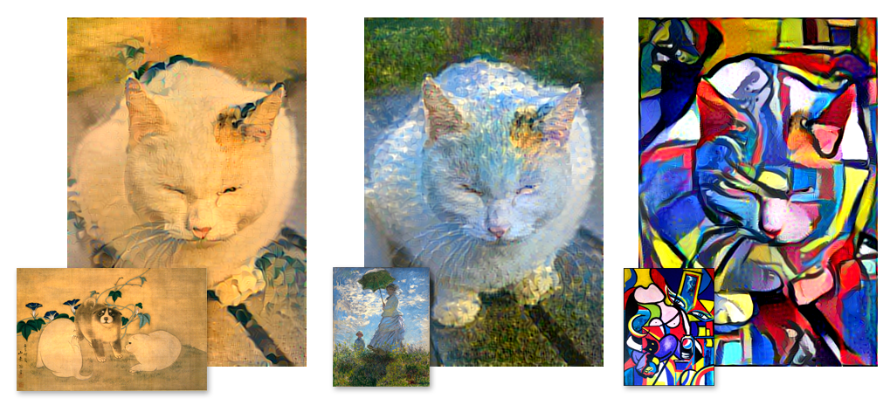
Motivation
Inspiring capabilities for transforming daily scenes into art.
Great existing tools for each task.
None combining the two(!)
None applying multiple (non mixed) styles to single image.
None allowing user control over output.

Slide 4
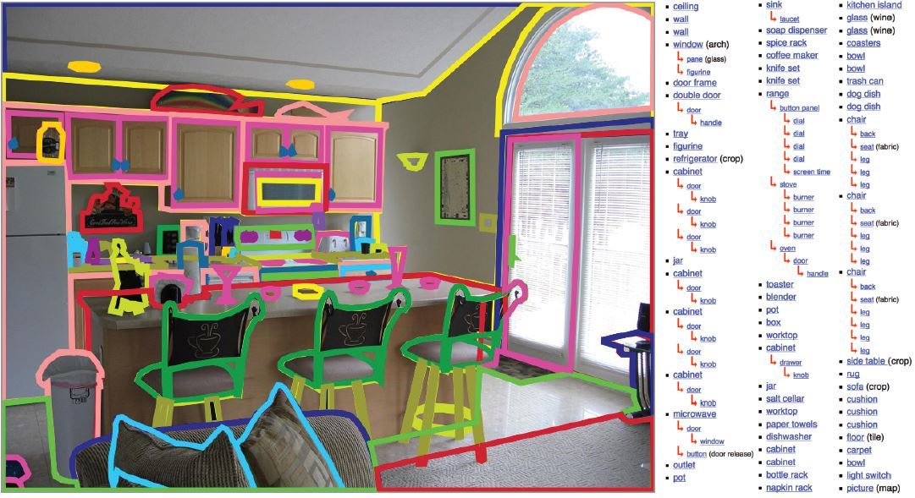
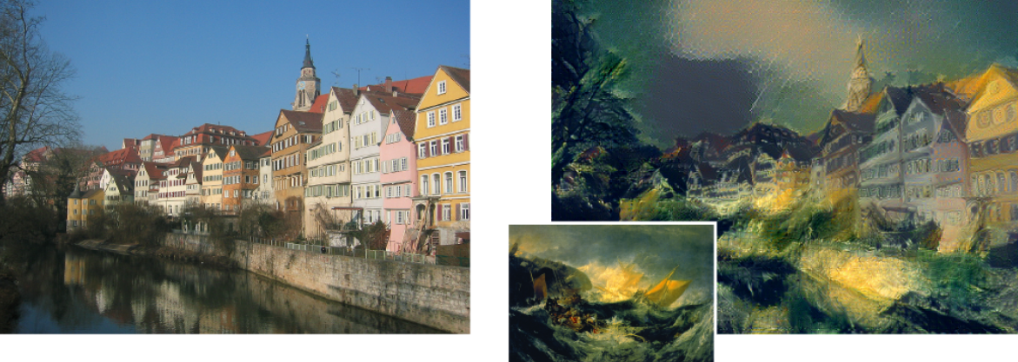
Related Work
Scene Parsing through ADE20K Dataset**
New dataset exhaustively annotated with objects.
VGG19 based pipeline.
High quality semantic segmentation.
A Neural Algorithm of Artistic Style*
Composing a complex interplay between the content and style of an image.
Creates artistic images of high perceptual quality.
Algorithmic perception of artistic imagery.
(*) Leon A Gatys, Alexander S Ecker, and Matthias Bethge. A neural algorithm of artistic style. arXiv preprint arXiv:1508.06576, 2015.
(**) Bolei Zhou, Hang Zhao, Xavier Puig, Sanja Fidler, Adela Barriuso and Antonio Torralba. Scene parsing through ade20k dataset. InProceedings of the IEEE Con-ference on Computer Vision and Pattern Recognition, volume 1, page 4. IEEE, 2017.

Slide 5
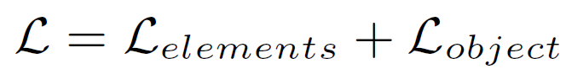
Scene Parsing Loss Evaluation
Per pixel cross entropy loss:
Overall Loss:
Or:

Slide 6
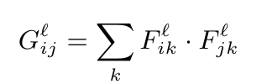
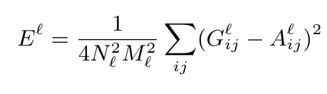
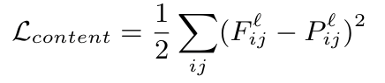
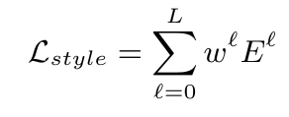
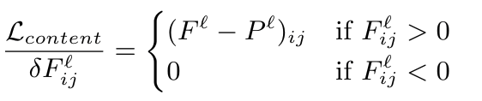
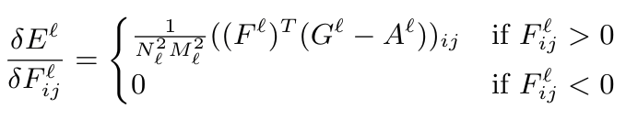
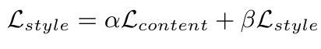
Style Transfer Loss Evaluation
Style Loss:
Content Loss
Overall Loss:

Slide 7

Approach
Step 1 - Parsing Input Image scene to different objects (Segmentation)
Step 2 - Obtaining object corresponding masks
Implementing user choices and selections.
Step 3 - Generate style per objects
Step 4 - Minimize loss over content and style
Step 5 - Combine artistic objects together

Slide 8
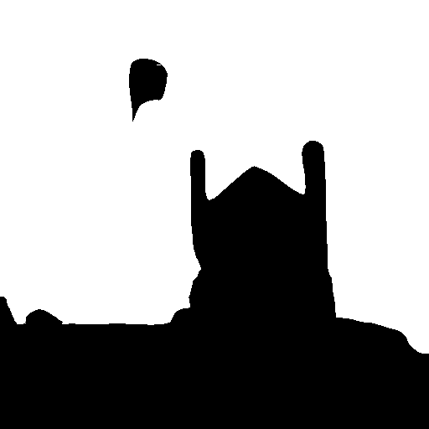
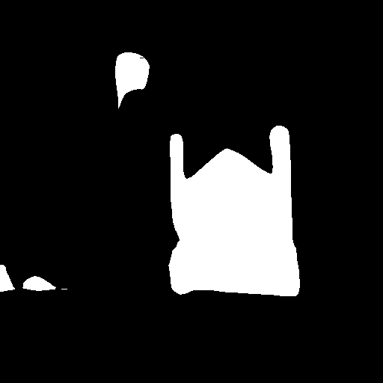

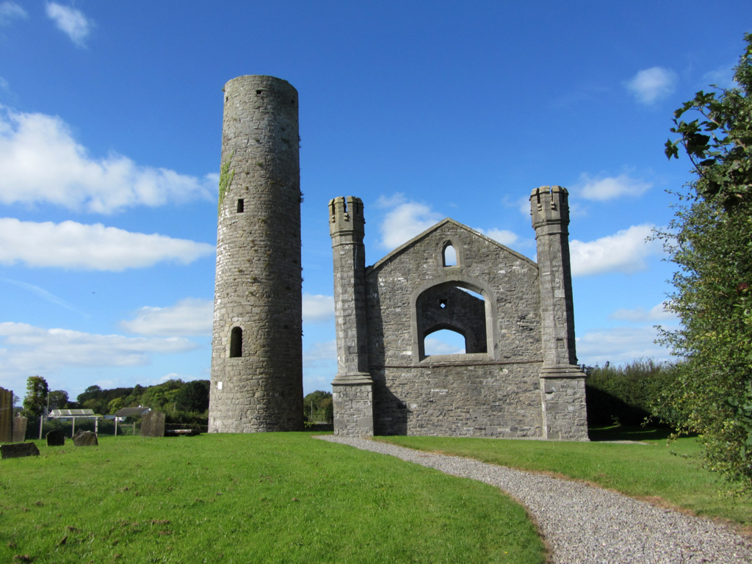
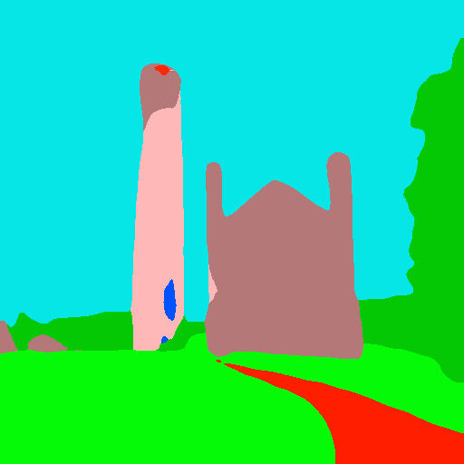
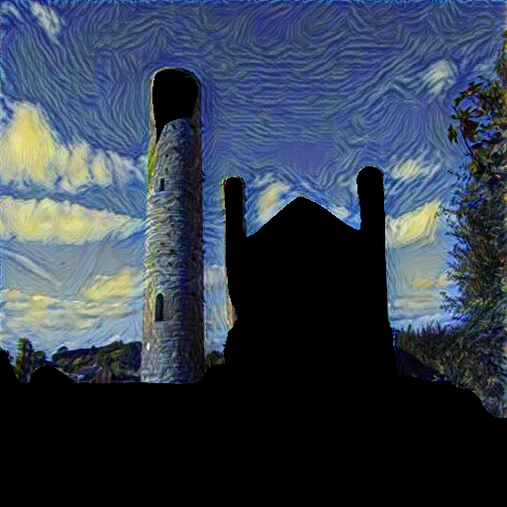
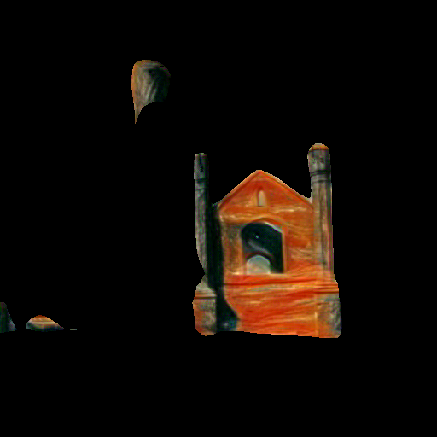
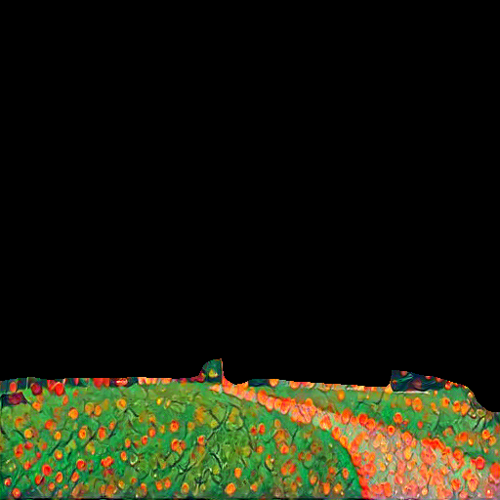
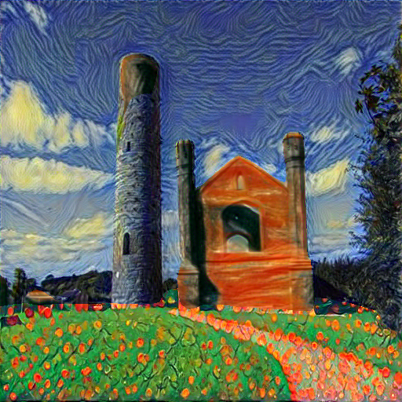

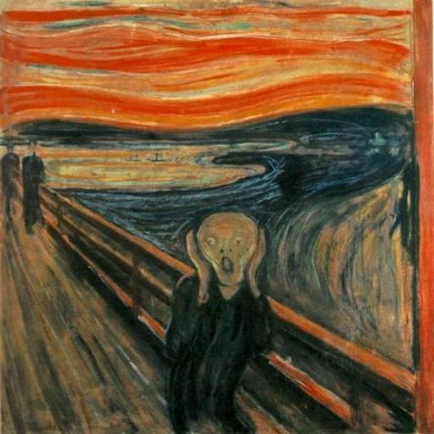
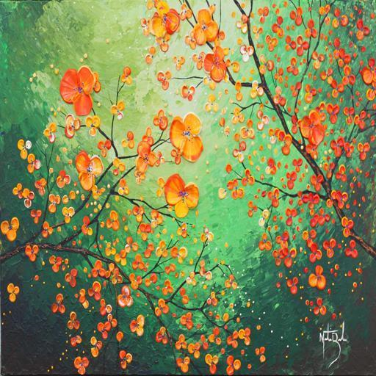
Implementation
Sub-Masks
Input image
Masks
Output image
Styles

Slide 9
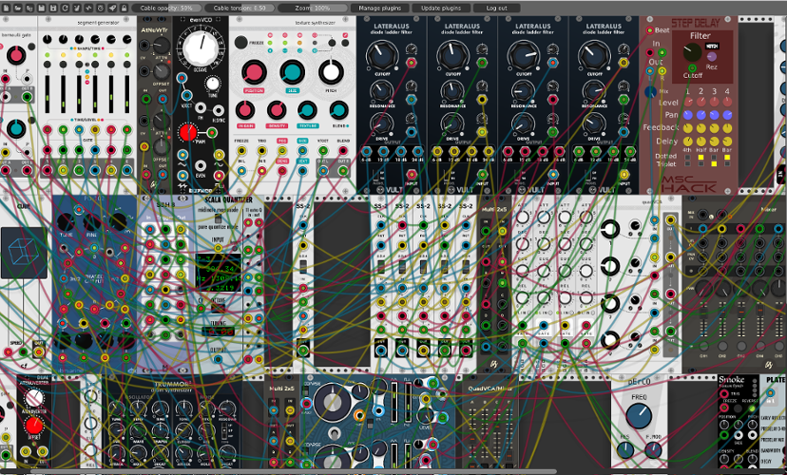
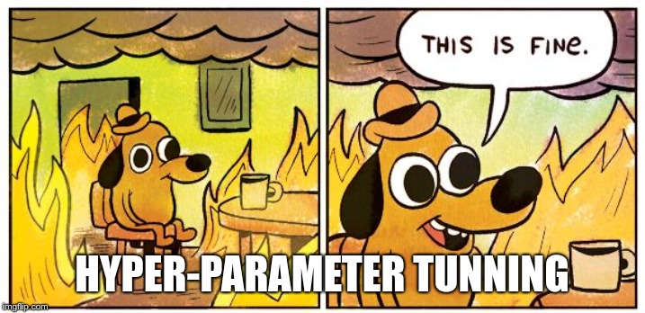
Experiments and Results
Experimenting with:
Set of layers to be used for content & style
Various pre-trained networks
Content and style weights in style transfer module.
Number of epochs for style transfer

Slide 10
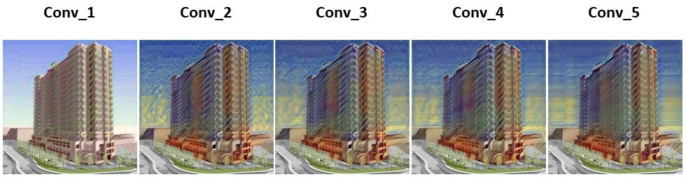
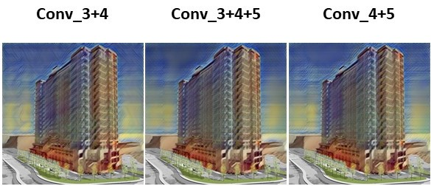
Experiments and Results cont.
Testing different Style Loss Layers
Best results for Layers 3-5
Testing multiple Layers
Additional layers increase smears.
Single layer captures superior style characteristics.

Slide 11
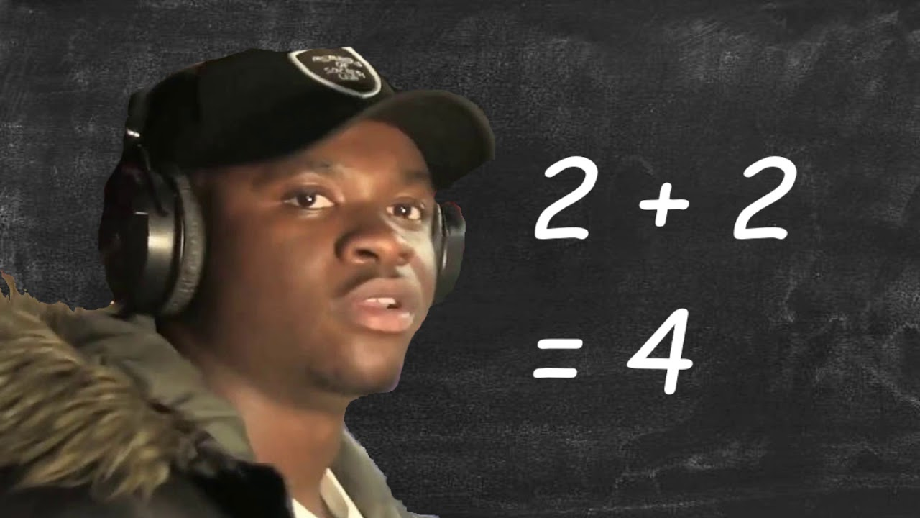
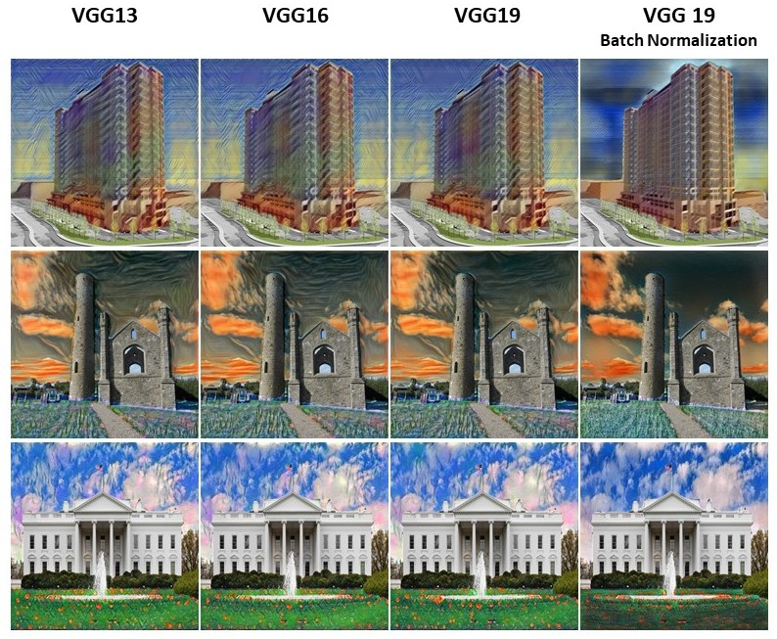
Experiments and Results cont.
Testing different Content Loss Layers
Each conv layer was beneficial to content loss, so all layers were used.
VGG models comparison
Similar results for less parameters
Batch Normalization hurts style characteristics on account of content.
Quick mafs

Slide 12
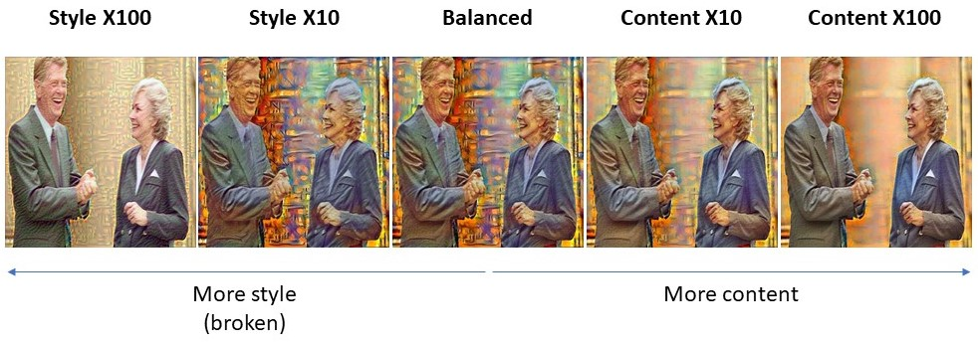
Experiments and Results cont.
Testing style and content weights
Broken

Slide 13
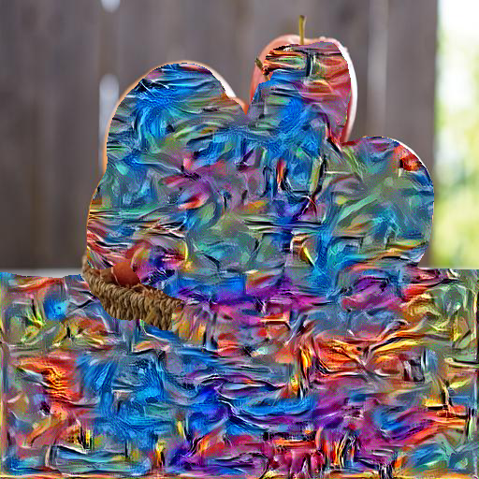
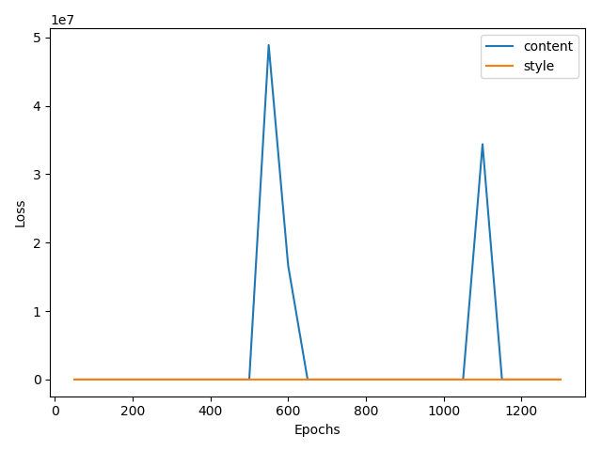
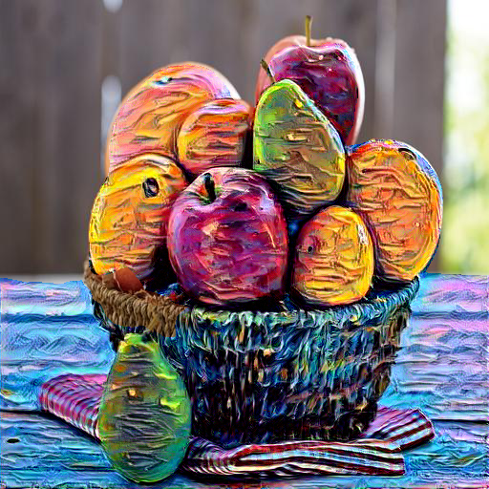
Experiments and Results cont.
Testing number of epochs for style transfer
Noticed jumps in content loss
With Early Stopping implementation

Slide 14
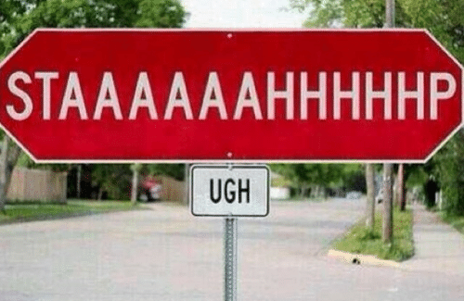
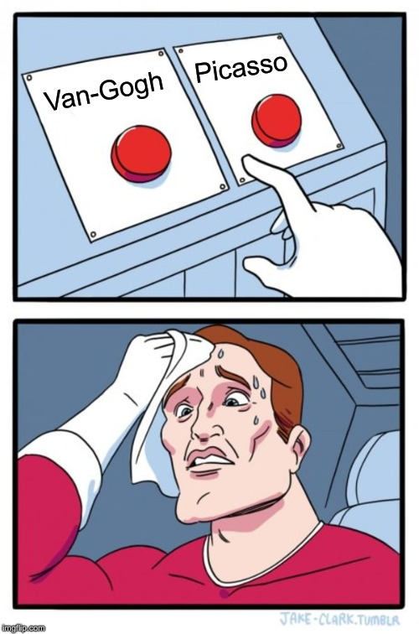
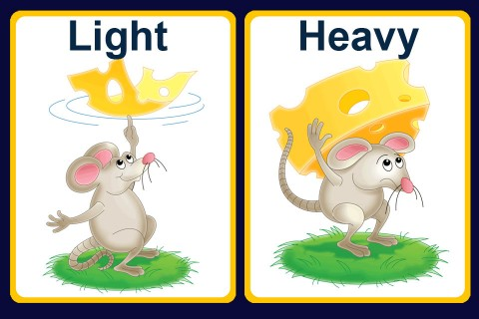
Contribution
Parameter Reduction in Style Transfer
User Choices & Preferences
Early Stopping

Slide 15
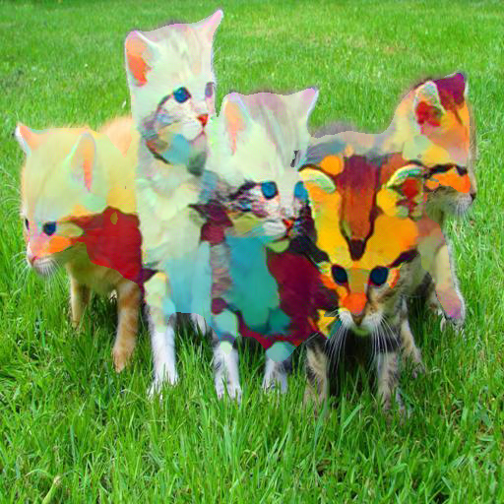
Conclusion and Future Work
Designed novel Cut N’ Paste tool for Segmented Style Transfer
Easy-to-use
Off-the-shelf
Cut N’ Paste incorporates:
Multiple styles for single input image.
Style-per-Object possibilities.
User choices and preferences.
Early Stopping mechanism.
Future Work: Adding GUI for user selection of Style Transfer areas.

Slide 16
Questions?
Thank you!

